Slide 1
Introduction
These days, health concept has become quite popular. An increase in popularity has especially increased in visiting website online. So, online medical services are becoming more popular day by day.

Slide 2
Features
Hospital’s location
Doctor’s availability
Doctor’s appointment
Online pharmacy
Ambulance service

Slide 3
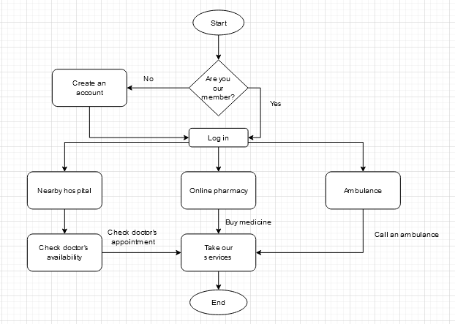
Diagram

Slide 4
Hospital’s Services
Click on “Hospital’s location” option
Search location
No nearby hospital?
Search again

Slide 5
Doctor’s Services
Click on “Doctor” option
Search doctor
Is your doctor available?
Search another doctor

Slide 6
Online Pharmacy
Click on “Pharmacy” option
Search your location
Find pharmacy
Search your medicine
Buy

Slide 7
Ambulance Service
Click on “Ambulance” option
Search your location
Find nearby hospital
Find ambulance
Call ambulance

Slide 8
Payment System
Cash on delivery
Bkash
Nogod
Rocket
On spot payment

Slide 9
Future Plan
Live chat system
Live doctor’s service
Add more hospitals
Add more doctors
Add category

Slide 10
Conclusion
Living a healthy life, medical help is necessary. Leading a busy day, online medical services are becoming popular day by day. It saves our time, reduce our cost and make our life easier. In future, we will depend on online services and online medical services is one of them.

